Slide 1







Whole-Genome Approach to Plant Phenotype Prediction
Tatiana Tatarinova

Slide 2


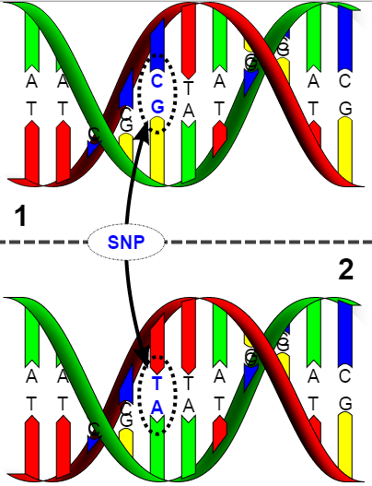
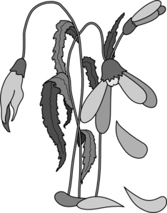
So what is GWAS?
Genome Wide Association Study
Looking for SNPs…
associated with a phenotype.
Purpose:
Explain
Understanding
Mechanisms
Therapeutics
Predict
Intervention
Prevention
Understanding not required

Slide 3
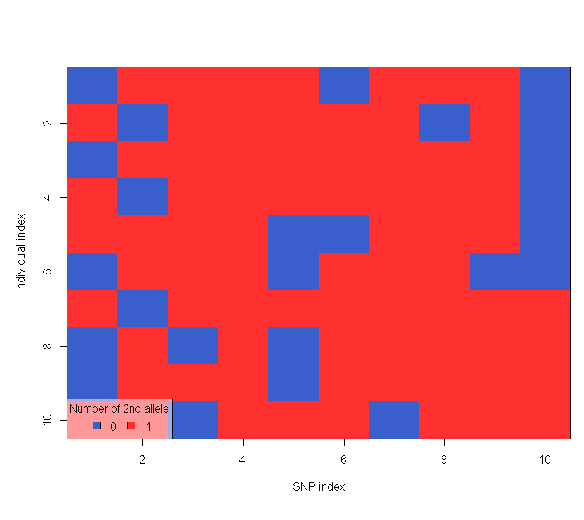



Association
p SNPs
Definition
Any relationship between two measured quantities that renders them statistically dependent.
Heritability
The proportion of variance explained by genetics
P = G + E + G*E
Heritability > 0
Controls
Cases
n individuals

Slide 4



Association
p SNPs
Definition
Any relationship between two measured quantities that renders them statistically dependent.
Heritability
The proportion of variance explained by genetics
P = G + E + G*E
Heritability > 0
Controls
Cases
n individuals

Slide 5

Why?
Environment, Gene-Environment interactions
Complex traits, small effects, rare variants
Gene expression levels
GWAS methodology?

Slide 6




GWAS design
Case-Control
Well-defined “case”
Known heritability
Variations
Quantitative phenotypic data
Eg. Height, biomarker concentrations
Explicit models
Eg. Dominant or recessive

Slide 7
GWAS design
Case-Control
Well-defined “case”
Known heritability
Variations
Quantitative phenotypic data
Eg. Height, biomarker concentrations
Explicit models
Eg. Dominant or recessive

Slide 8
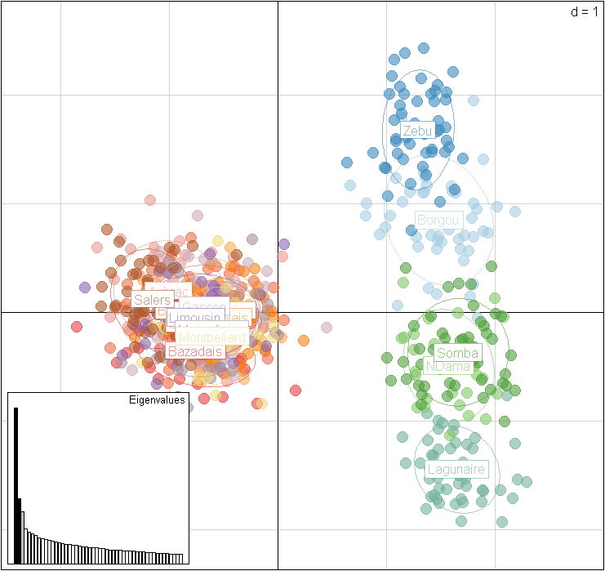
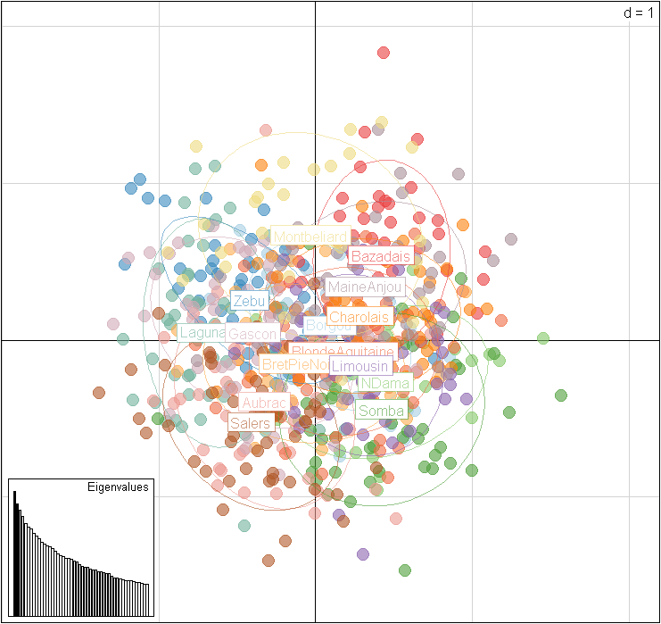
Population stratification II
Solutions
Visualise
Phylogenetics
PCA
Correct
Genomic Control
Regression on Principal Components of PCA

Slide 9
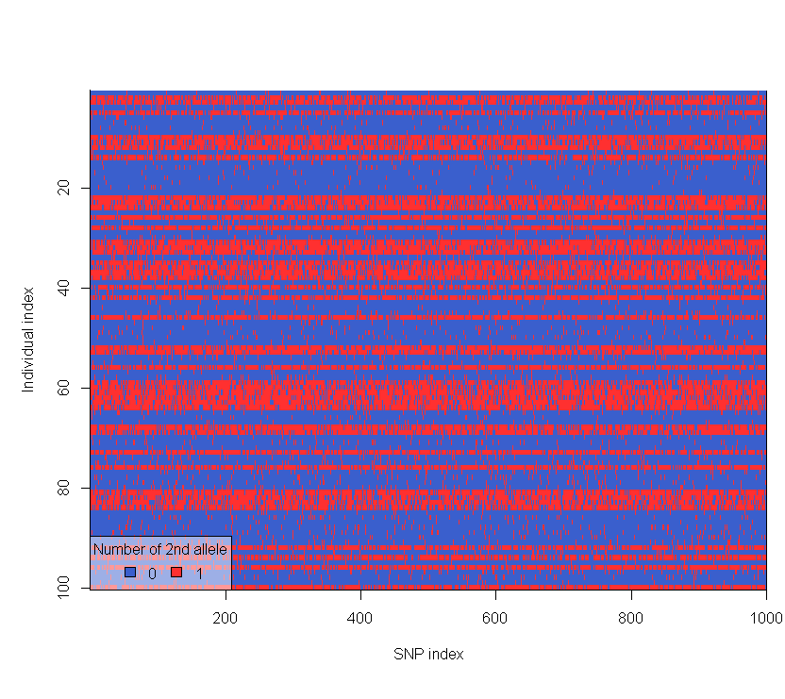
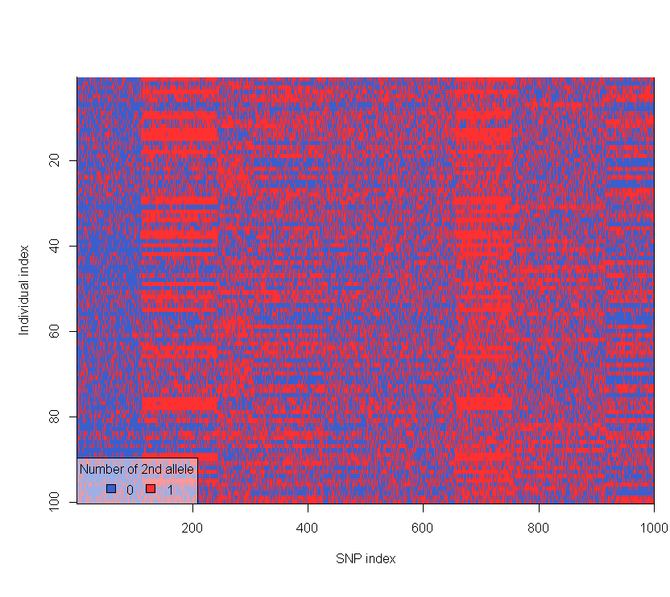
Linkage disequilibrium (LD)
Definition
Alleles at separate loci are NOT independent of each other
Problem? Yes and No
Too much LD is a problem
→ noise >> signal
Some (predictable) LD can be beneficial
→ enables use of “marker” SNPs

Slide 10


Methods for association testing
Standard GWAS
Univariate methods
Incorporating interactions
Multivariate methods
Penalized regression methods (LASSO)
Factorial methods (DAPC-based FS)

Slide 11
Univariate methods
p SNPs
Approach
Individual test statistics
Correction for multiple testing
Controls
Cases
Variations
Testing
Fisher’s exact test, Cochran-Armitage trend test, Chi-squared test, ANOVA
Gold Standard—Fischer’s exact test
Correcting
Bonferroni
Gold Standard—FDR
n individuals

Slide 12
Univariate – Strengths & weaknesses
Strengths
Weaknesses
Straightforward
Computationally fast
Conservative
Easy to interpret
Multivariate system, univariate framework
Effect size of individual SNPs may be too small
Marginal effects of individual SNPs ≠ combined effects

Slide 13
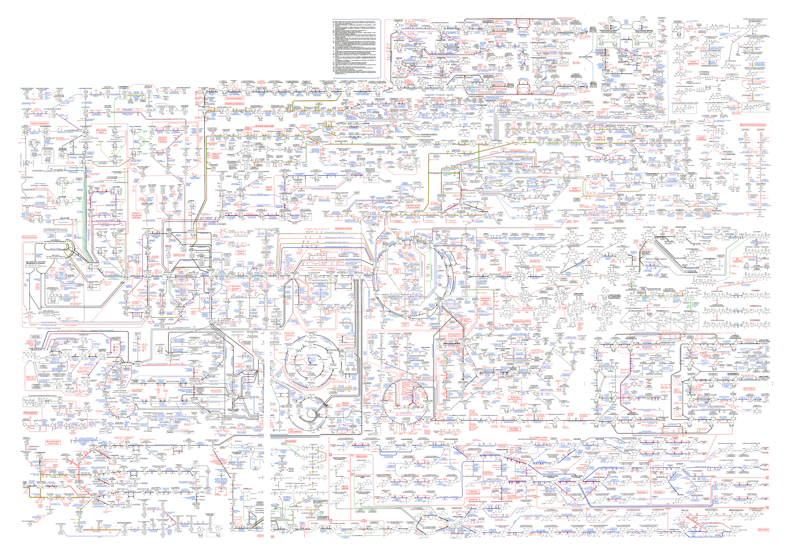
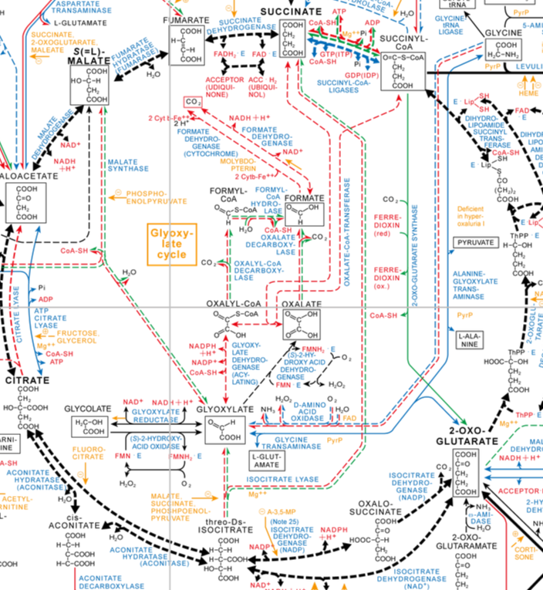
What about interactions?

Slide 14
Multivariate methods
Neural Networks
Penalized Regression
Genetic programming optimized neural networks
LASSO penalized regression
Parametric
decreasing method
The elastic net
Ridge regression
Logic Trees
Logic feature selection
Monte Carlo
Logic Regression
Bayesian Approaches
Logic regression
Bayesian partitioning
Modified Logic Regression-Gene Expression Programming
Bayesian Logistic Regression with Stochastic Search Variable Selection
Bayesian Epistasis Association Mapping
Genetic Programming for Association Studies
Set association
approach
Factorial Methods
Non-parametric Methods
Sparse-PCA
Multi-factor dimensionality reduction method
Random forests
Restricted
partitioning method
Supervised-PCA
DAPC-based FS (snpzip)
Combinatorial partitioning method
Odds-ratio-
based MDR

Slide 15
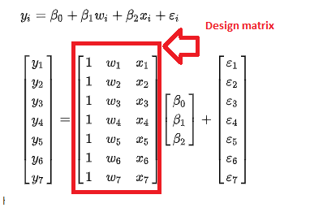
GWAS
Ridge regression using rrBLUP package
Ridge regression BLUP (Meuwissen et al. 2001)
https://rdrr.io/cran/rrBLUP/man/GWAS.html
Marker effects model
Y – data vector
µ - overall mean
1 – vector of 1s
X_{i} - design matrix
g – genetics effect of the i^{th} marker
e - error
y = µ1 + ∑X_{i} g_{i} + e
Excellent online resources: https://pbgworks.org/index.php?q=node/1440
Ridge regression is a way to create a model when the number of predictor variables in a set exceeds the number of observations (data-poor situation)

Slide 16
R code: install and load the required libraries
library(qqman)
library(poolr)
library(OpenStreetMap)
library(rjson)
library(rgdal)
library(RgoogleMaps)
library(mapproj)
library(sf)
library(dplyr)
Library(devtools)
devtools::install_github("dkahle/ggmap", ref = "tidyup")
install.packages(c("poolr","qqman","BGLR","rrBLUP","DT", "SNPRelate","dplyr ","RgoogleMaps", "ggmap", "mapproj", "sf", "OpenStreetMap", "devtools“))
install.packages(c("rnaturalearth",'rnaturalearthdata','rgeos',' ggspatial'))
library(rrBLUP)
library(BGLR)
library(DT)
library(SNPRelate)
library(rgeos)
library(ggspatial)

Slide 17
Download datasets
sativas413.ped
sativas413.fam
sativas413.map
sativas413.pheno
sativas413.csv

Slide 18
Step 1. Read SNP data into R
rm(list = ls())
setwd(“#your working directory containing file")
Geno <- read_ped("sativas413.ped")
head(Geno)
#conatins the marker allele data in 0, 1, 2, and 3 format; 2 represents missing data
p = Geno$p;p
n = Geno$n;n
Geno = Geno$x;Geno
# Accession information
FAM <- read.table("sativas413.fam");FAM
# Map information
MAP <- read.table("sativas413.map");MAP
# Recode the data in ped file
Geno[Geno == 2] <- NA # Converting missing data to NA
Geno[Geno == 0] <- 0 # Converting 0 data to 0
Geno[Geno == 1] <- 1 # Converting 1 to 1
Geno[Geno == 3] <- 2 # Converting 3 to 2
# Convert the marker data into matrix and transpose and check dimensions
Geno <- matrix(Geno, nrow = p, ncol = n, byrow = TRUE)
Geno <- t(Geno)
dim(Geno)

Slide 19
Step 2. Read phenotype data into R
##read phenotype
rice.pheno <- read.table("sativas413.pheno",
header = TRUE, stringsAsFactors = FALSE, sep = "\t")
# See first few columns and rows of the data
rice.pheno[1:5, 1:5]
dim(rice.pheno)
# compare it with phenotypic file
rownames(Geno) <- FAM$V2
table(rownames(Geno) == rice.pheno$NSFTVID)
# Now let us extract the first trait and assign it to object y
y <- matrix(rice.pheno$Flowering.time.at.Arkansas) # use the first trait
rownames(y) <- rice.pheno$NSFTVID
index <- !is.na(y)
y <- y[index, 1, drop = FALSE] # 374
Geno <- Geno[index, ] # 374 x 36901
table(rownames(Geno) == rownames(y))

Slide 20
Step 3. Filtering SNP data
#Here we will be using for loop to identify the missing ones and convert them with mean values across columns.
for (j in 1:ncol(Geno)) {
Geno[, j] <- ifelse(is.na(Geno[, j]), mean(Geno[, j], na.rm = TRUE), Geno[, j])
}
#Here we will be dropping the alleles with frequency < 5% and saving the object as Geno1
#Then we will match and drop the markers from map info file and save it as MAP1
# Filter for minor alleles
p <- colSums(Geno)/(2 * nrow(Geno))
maf <- ifelse(p > 0.5, 1 - p, p)
maf.index <- which(maf < 0.05)
Geno1 <- Geno[, -maf.index]
dim(Geno1)
dim(Geno)
#subset based on retained SNPs
MAP1 <- MAP[-maf.index, ]; dim(MAP1)

Slide 21
Step 4. Population structure
# Create geno matrix file and assign the row and column names from fam and map files
Geno1 <- as.matrix(Geno1)
sample <- row.names(Geno1)
length(sample)
colnames(Geno1) <- MAP1$V2
snp.id <- colnames(Geno1)
length(snp.id)
snpgdsCreateGeno("44k.gds", genmat = Geno1, sample.id = sample, snp.id = snp.id,
snp.chromosome = MAP1$V1, snp.position = MAP1$V4, snpfirstdim = FALSE)
# Now open the 44k.gds file
geno_44k <- snpgdsOpen("44k.gds")
snpgdsSummary("44k.gds")

Slide 22
Step 5. PCA
#PCA analysis
pca <- snpgdsPCA(geno_44k, snp.id = colnames(Geno1))
#plot results of PCA
pca <- data.frame(sample.id = row.names(Geno1), EV1 = pca$eigenvect[, 1], EV2 = pca$eigenvect[, 2], EV3 = pca$eigenvect[, 3], EV4 = pca$eigenvect[, 4], stringsAsFactors = FALSE)
plot(pca$EV2, pca$EV1, xlab = "eigenvector 3", ylab = "eigenvector 4")
#add population information to the plot
pca_1 <- read.csv("sativas413.csv", header = TRUE, skip = 1, stringsAsFactors = FALSE
pca_2 <- pca_1[match(pca$sample.id, pca_1$NSFTV.ID), ]
# Extract the population information and add the PCA output file
pca_population <- cbind(pca_2$Sub.population, pca)
colnames(pca_population)[1] <- "population"
# Plot and add the population names
plot(pca_population$EV1, pca_population$EV2, xlab = "PC1", ylab = "PC2", col = c(1:6)[factor(pca_population$population)])
legend(x = "topright", legend = levels(factor(pca_population$population)), col = c(1:6), pch = 1, cex = 0.6)

Slide 23
Step 5a. PCA visualization
# Extract the location information and add the PCA output file
pca_country <- as.data.frame(cbind(as.numeric(pca$EV1),as.numeric(pca$EV2),as.numeric(pca$EV3),as.numeric(pca$EV4),as.numeric(pca_2$Latitude), as.numeric(pca_2$Longitude)));head(pca_country)
names(pca_country)=c('PC1','PC2','PC3','PC4','LAT','LONG')
pca_country=na.omit(pca_country)
#correlation with geography
cor(pca_country[,1:6],use='pairwise.complete.obs')
# load data
world <- ne_countries(scale = "medium", returnclass = "sf")
# extract locations
world_points<- st_centroid(world)
# extract labels
world_points <- cbind(world, st_coordinates(st_centroid(world$geometry)))
#define colors for the map
NCOLS=max(unique(round(50*(pca_country$PC3+0.11))));NCOLS
COL=rainbow(NCOLS)

Slide 24
Step 5b. PCA visualization
ggplot(data = world) +
geom_sf() +
labs( x = "Longitude", y = "Latitude") +
ggtitle("World map", subtitle = paste0("(", length(unique(world$admin)), " countries)"))+
annotation_scale(location = "bl", width_hint = 0.5) +
annotation_north_arrow(location = "bl", which_north = "true",
pad_x = unit(0.75, "in"), pad_y = unit(0.5, "in"),
style = north_arrow_fancy_orienteering) +
theme_bw()+theme(panel.grid.major = element_line(color = "gray60", linetype = "dashed", size = 0.25),
panel.background = element_rect(fill = "aliceblue")) +
geom_text(data= world_points,aes(x=X, y=Y, label=name),
color = "gray20", fontface = "italic", check_overlap = T, size = 3)+
geom_point(data = pca_country, aes(x = LONG, y = LAT), size = 4, shape = 24,
fill = COL[round(50*(pca_country$PC3+0.11))])

Slide 25
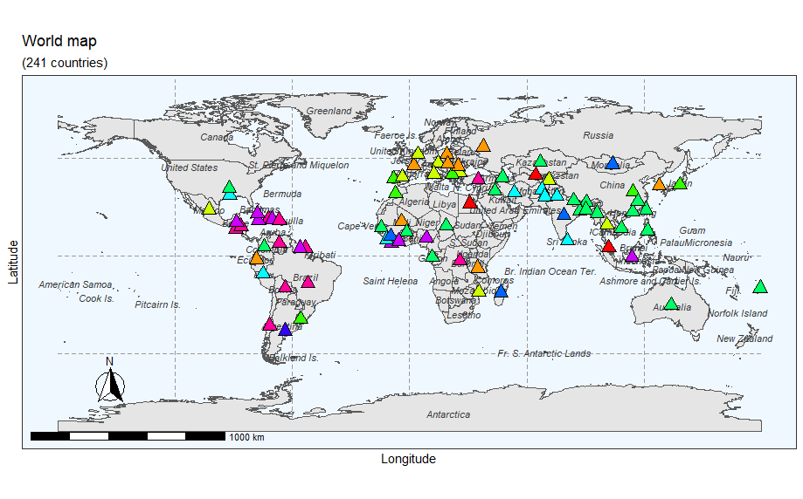
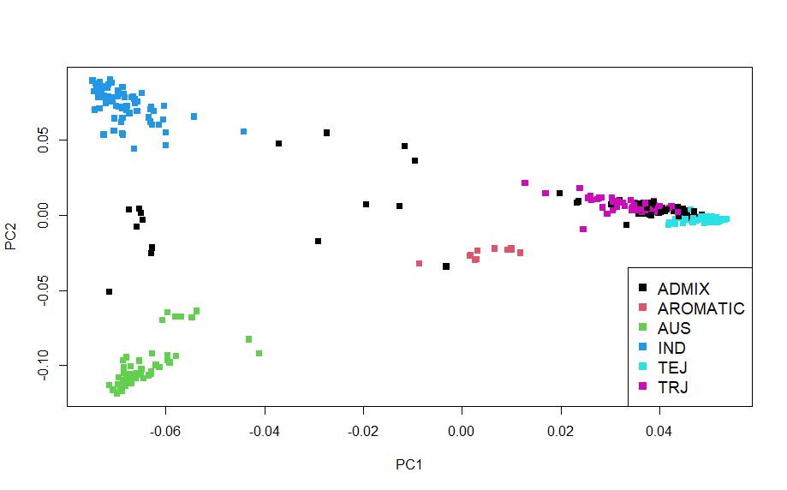
PCA analysis: color by population and by geography

Slide 26
GWAS
# create the geno file for rrBLUP package GWAS analysis
geno_final <- data.frame(marker = MAP1[, 2], chrom = MAP1[, 1], pos = MAP1[, 4], t(Geno1 - 1), check.names = FALSE)
dim(Geno1)
# create the pheno file
pheno_final <- data.frame(NSFTV_ID = rownames(y), y = y)
# Run the GWAS analysis
myGWAS <- GWAS(pheno_final, geno_final, min.MAF = 0.05, P3D = TRUE, plot=TRUE)

Slide 27
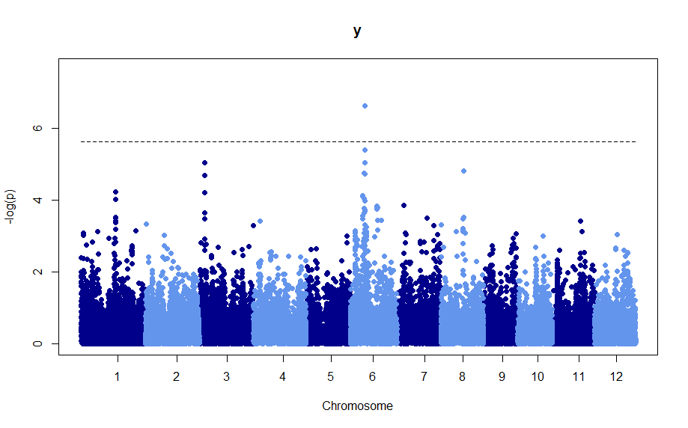

Slide 28
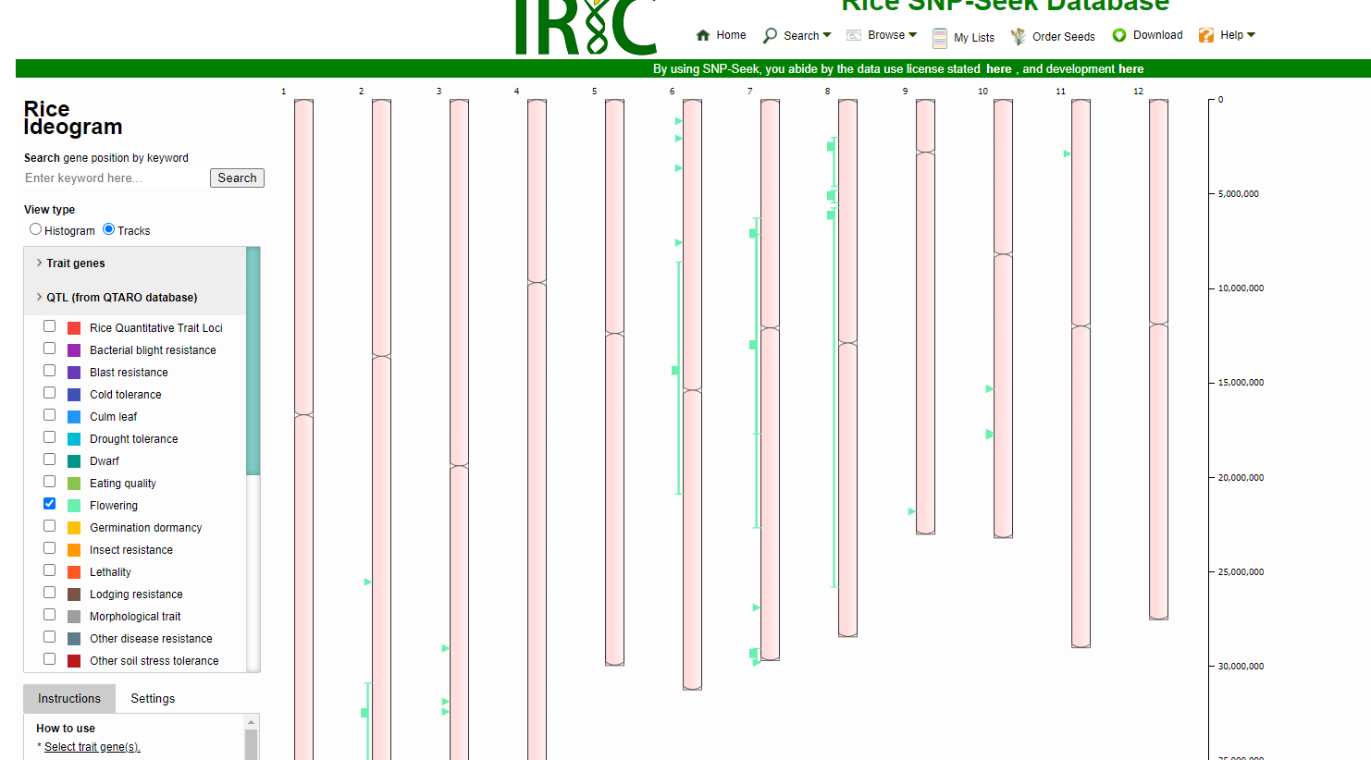
Use SNP-seek
https://snp-seek.irri.org/

Slide 29
There are many newer tools
However, if you master the old good rrBLUP, it will help understand the others
Now, exercise
Look at available phenotypes, select one and repeat the excercies.
"Flowering.time.at.Arkansas" "Flowering.time.at.Faridpur" "Flowering.time.at.Aberdeen" "FT.ratio.of.Arkansas.Aberdeen" "FT.ratio.of.Faridpur.Aberdeen" "Culm.habit" "Leaf.pubescence Flag.leaf.length" "Flag.leaf.width" "Awn.presence"
"Panicle.number.per.plant" "Plant.height" "Panicle.length" "Primary.panicle.branch.number" "Seed.number.per.panicle" "Florets.per.panicle" "Panicle.fertility" "Seed.length" "Seed.width" "Seed.volume" "Seed.surface.area" "Brown.rice.seed.length" "Brown.rice.seed.width" "Brown.rice.surface.area" "Brown.rice.volume" "Seed.length.width.ratio" "Brown.rice.length.width.ratio" "Seed.color”"Pericarp.color" "Straighthead.suseptability" "Blast.resistance"
"Amylose.content" "Alkali.spreading.value" "Protein.content"
"Year07Flowering.time.at.Arkansas" "Year06Flowering.time.at.Arkansas"

Slide 30
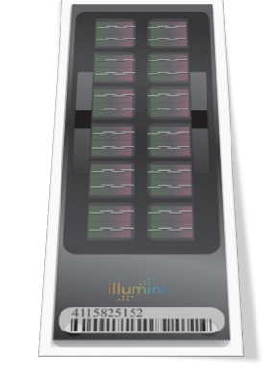
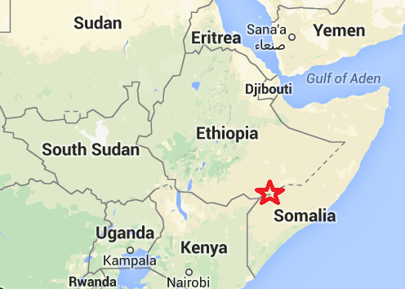

Geographic Population Structure (GPS) prediction approach
Infer position of the origin of an individual from whole-genome collection of ancestry-informative markers

Slide 31
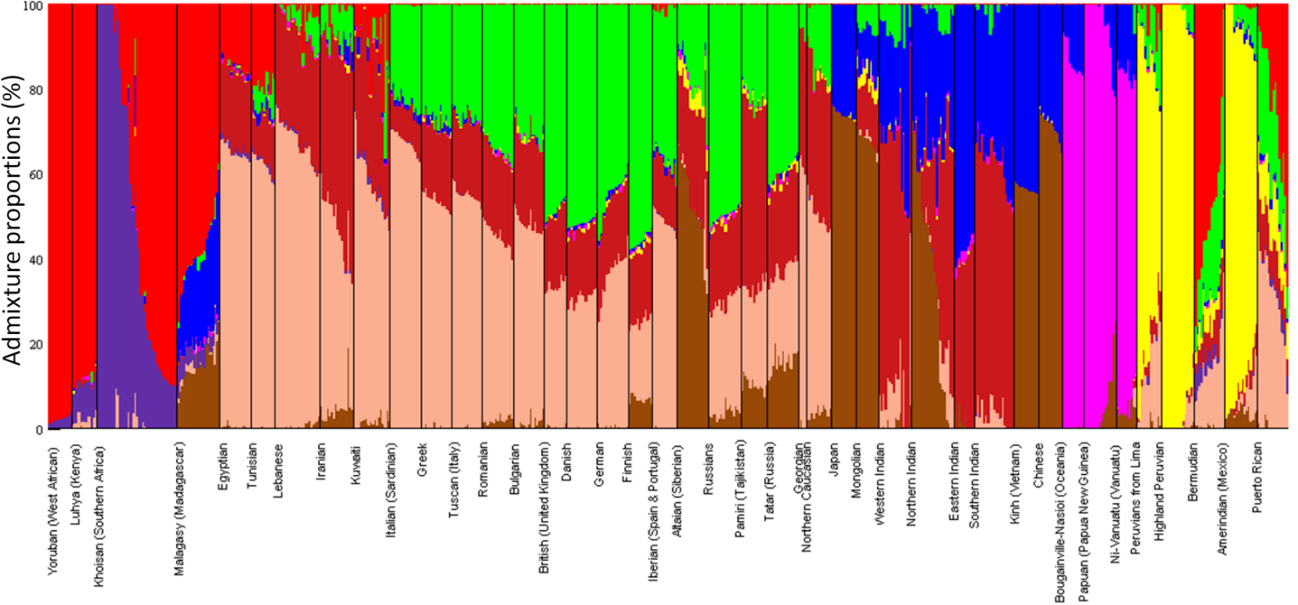
From SNPs to Admixture
To infer population structure from genotype data, it is necessary to first reduce the dimensionality of the dataset due to the thousands of SNPs it encompasses.
Thousands of SNPs
ADMIXTURE
 | North East Asian | Mediterranean | South African | South West Asian | Native American | Oceanian | South East Asian | Northern European | Sub-Saharan African
HGDP00985 | 0.5253 | 0.0202 | 0 | 0.2222 | 0.0404 | 0.0101 | 0.0101 | 0.1717 | 0
HGDP01094 | 0.04 | 0.04 | 0 | 0.03 | 0.83 | 0 | 0.01 | 0.05 | 0
HGDP00982 | 0.0102 | 0.1531 | 0.0306 | 0.0714 | 0.0408 | 0 | 0.0102 | 0.2041 | 0.4796
Admixture proportions in geographically adjacent populations, such as Italian and Greeks, and populations sharing similar history, like British and Germans, are similar.
Notes:
603 unrelated individuals representing 54 worldwide populations and subpopulations with ~15 samples per population. The results of the admixture analysis exhibit spatial patterns for individuals of the same genetic background that decreased in similarity with distance. In few places, the distribution of admixture proportion in geographically adjacent populations, such as Italian and Greeks, and populations sharing similar history, like British and Germans, overlapped.

Slide 32
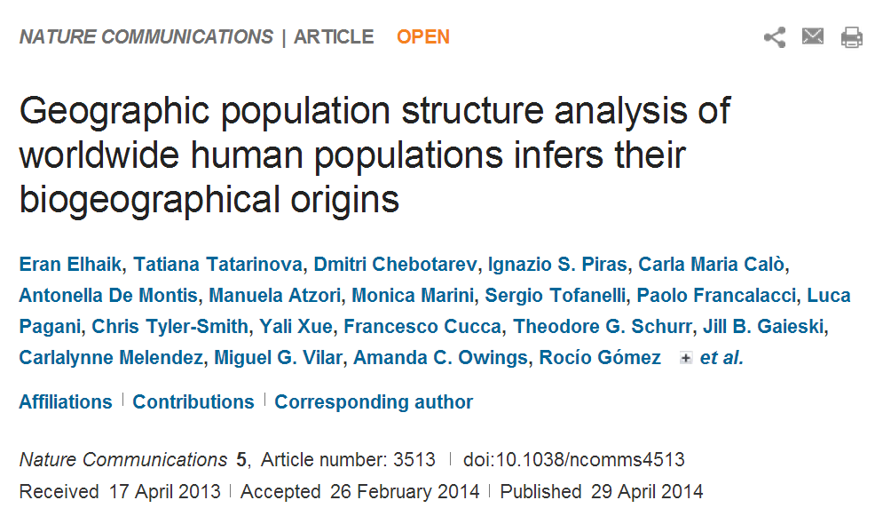

Slide 33
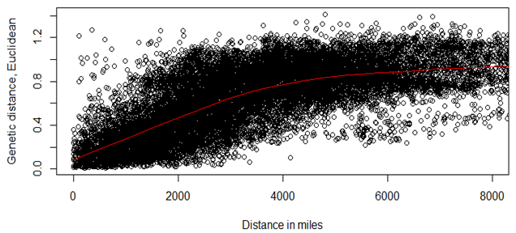



Prediction of bio-origin
Knowing relationship between geographic and genetic distances, is it possible to find a geographic origin of a person of known genotype?
We decided to try a simple approach
X
A
B

Slide 34
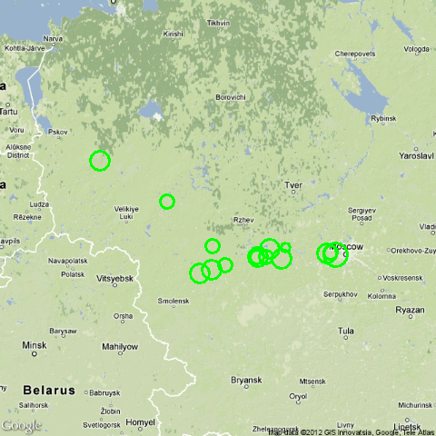
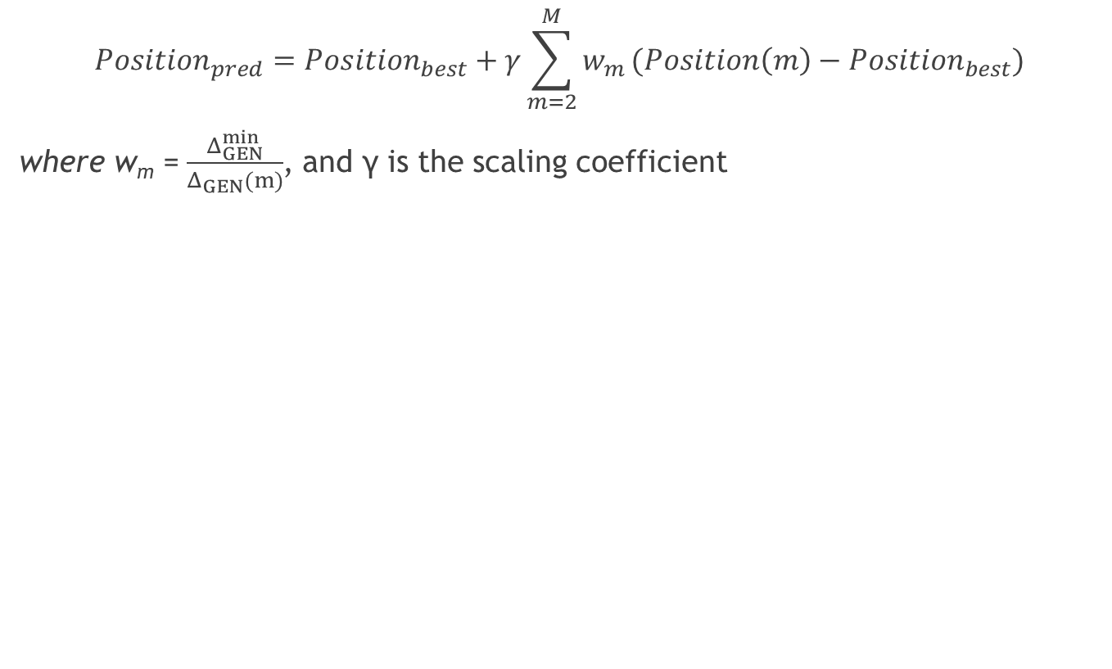
Unknown samples
$${Position}_{pred}={Position}_{best}+γ\sum_{m=2}^{M}{w_{m}}(Position\left(m\right)−{Position}_{best})$$
where w_{m} =$\frac{Δ_{GEN}^{min}}{Δ_{GEN}(m)}$, and γ is the scaling coefficient

Slide 35
GPS accurately assigned
~100% of all individuals to their continental regions
80% of all individuals to their country of origin
60% of all individuals to their inner-country region
Notes:
Populations for which inner-country data was available are marked with *. The average accuracy is calculated across populations given equal weights.

Slide 36
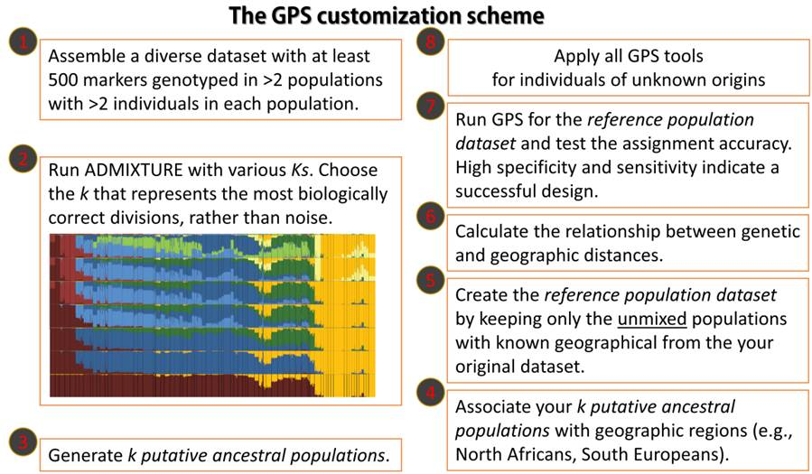
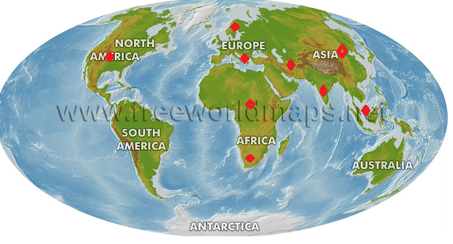
Modeling Admixture
Notes:
Used Admixture in unsupervised mode. We experimented with different Ks ranging from 6 to 10, until we identified a clear substructure at K=10. ADMXITURE outputs the speculated allele frequencies of each SNP for each K putative population.

Slide 37

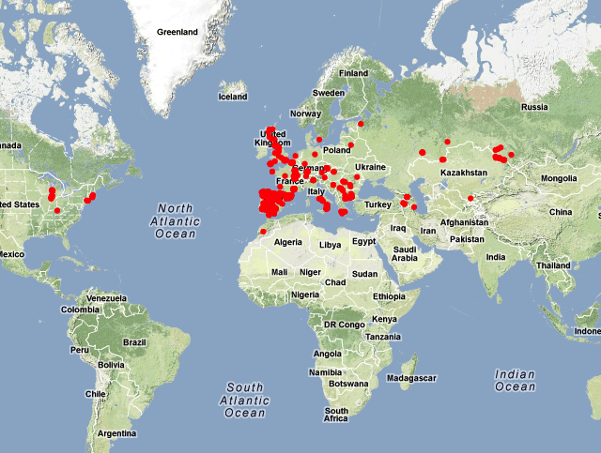
1001 Genomes - A Catalog of Arabidopsis thaliana Genetic Variation.
We took 450 inbred strains of A. thaliana from 22 countries sequenced and analyzed by Max-Plank Institute for Developmental Biology and Monsanto Company from 1001 Genomes project (http://1001genomes.org/projects/MPICWang2013/)
Samples from 22 countries
Genotype 250K SNP array
Collection point coordinates
Anton Eliseev/Kristina Krivonosova

Slide 38
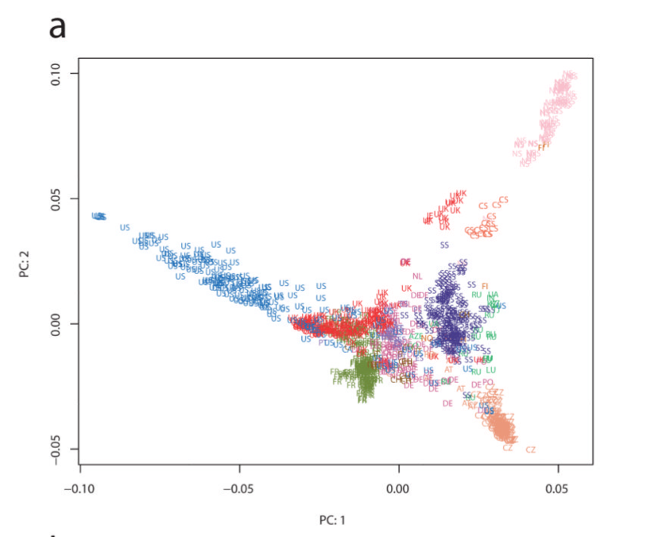
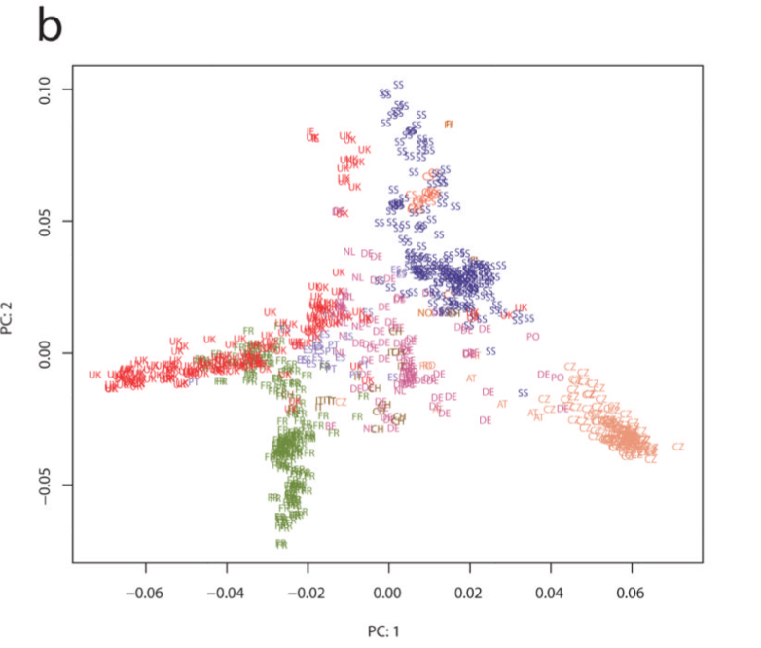
Population structure
Matthew W. Horton et al. Genome-wide patterns of genetic variation in worldwide A. thaliana accessions from the RegMap panel. Nat. Genet. 44(2)

Slide 39
Filtering SNPs
We took the variant files available at http://1001genomes.org/data/MPI/MPICWang2013/releases/current/
filtered out indels and non-autosomal variants. About ~8M variants were detected.
We picked 80,000 SNPs out of the original dataset and constructed a PLINK file.
Using PLINK, we removed SNPs with minor allele frequency < 0.05
and further removed LD with r² > 0.2 using window of size 50
The number of SNPs that remained is 40,518.

Slide 40
ADMIXTURE
We performed several ADMIXTURE analyses with number of ancestral populations K from 3 to 20, and then K=14 was chosen for subsequent analyses, because of it gave smallest median distance in leave-one-out validation
Then we split some of the initial populations into 41 genetically homogeneous subpopulations using K-means.

Slide 41
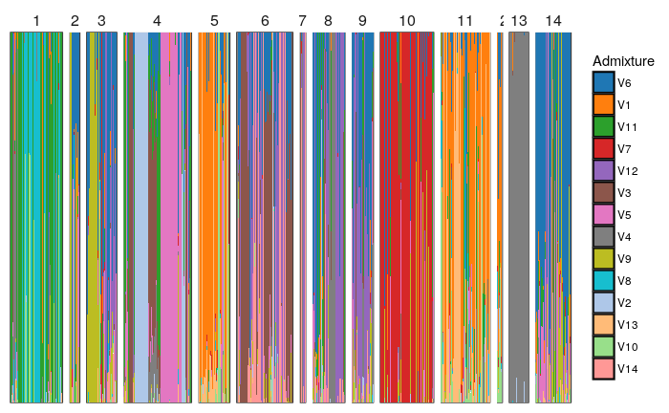
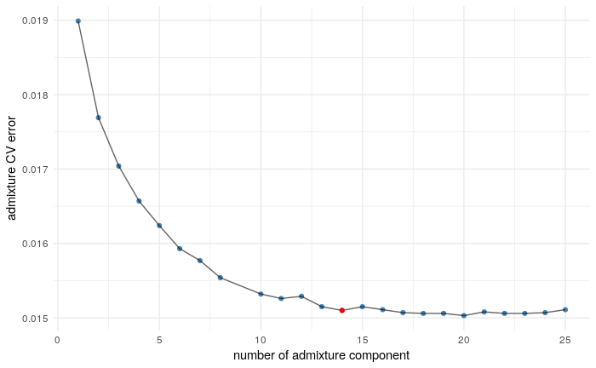
Admixture

Slide 42
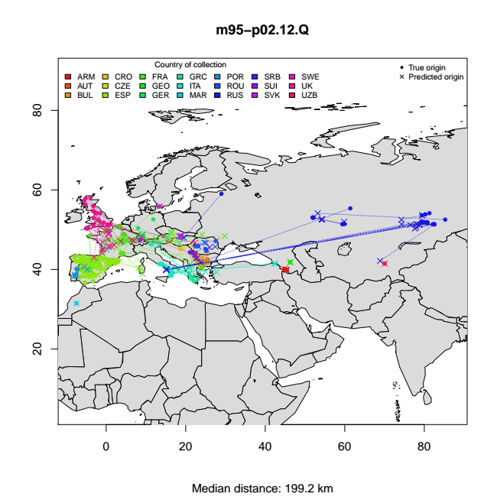
GPS Leave-one-out validation
Percent populations that are perfectly mapped 60%
Average distance to correct population 200 km

Slide 43
Initial Hypothesis
Geographic position of Arabidopsis should be associated with cold tolerance. Colder climate in Northern hemisphere is observed at higher latitudes. Plants may adapt to colder climates by adjusting flowering time. Therefore, we expect to see association with genes controlling flowering time and latitude.

Slide 44
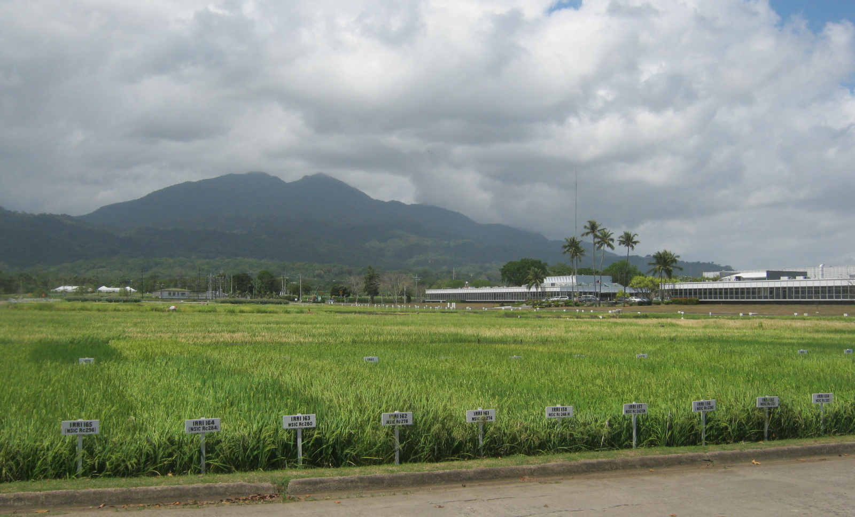
GPS analysis of O. sativa

Slide 45
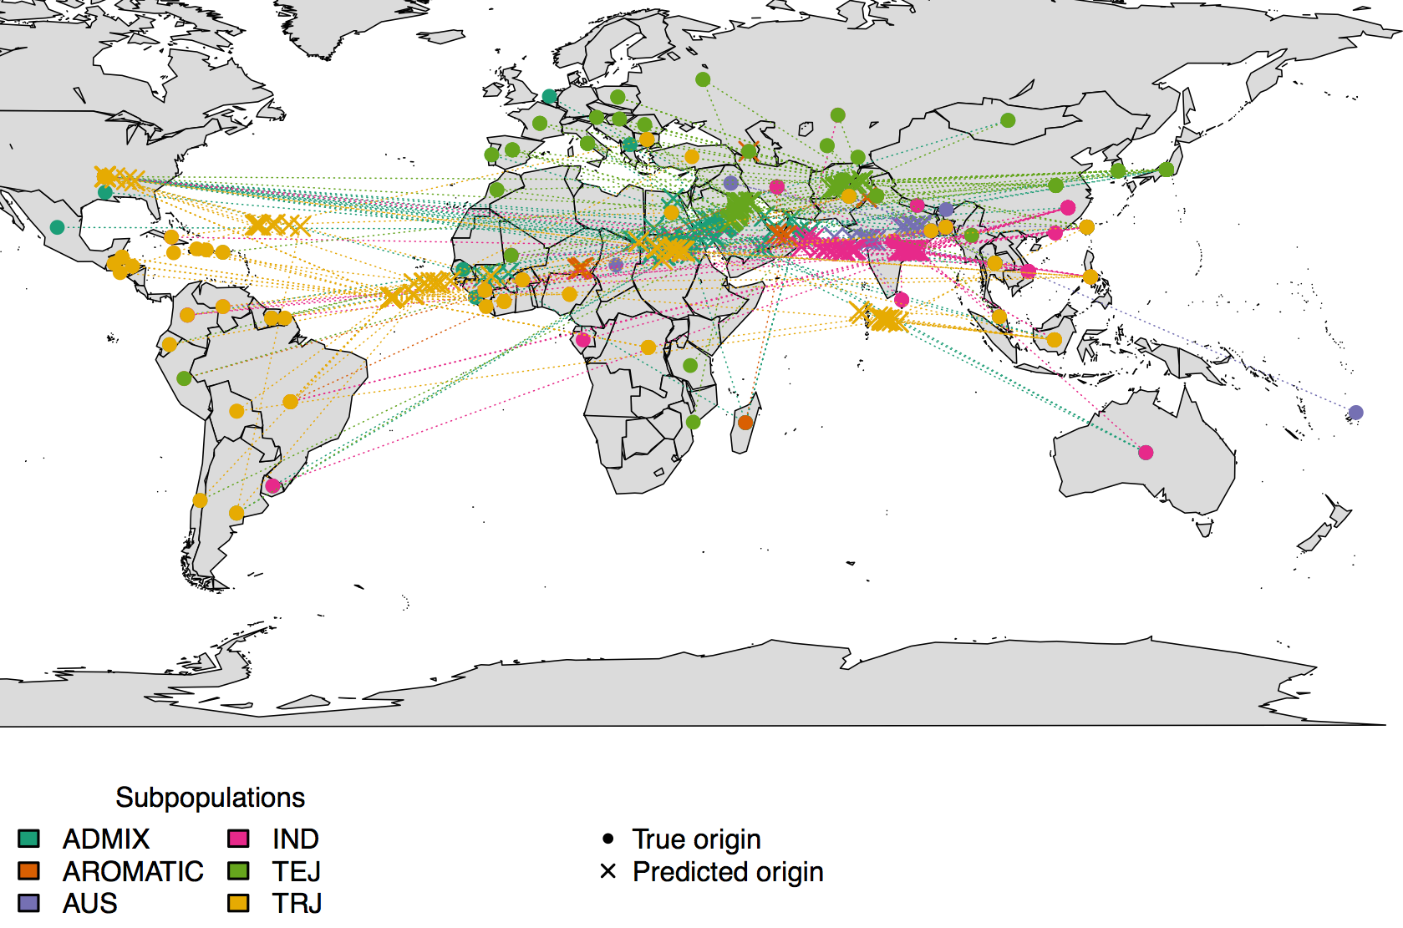
Accuracy for rice
Median distance: 4043 km

Slide 46
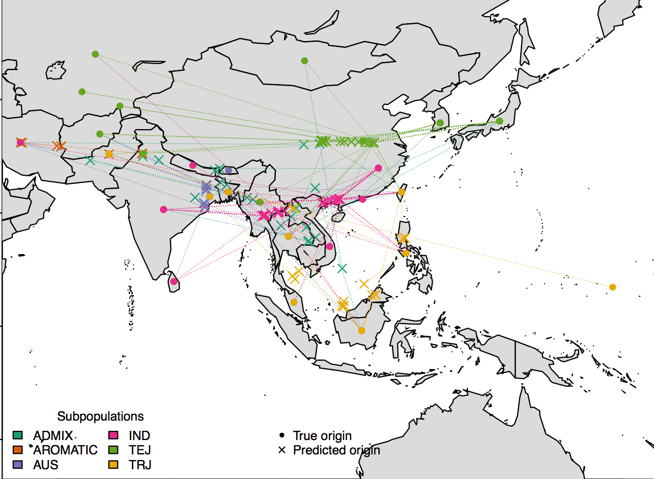
GPS prediction after SNP and geographic filtering
Median distance : 1141 km

Slide 47


Why does not work for rice?
Rice cannot choose its soul mate, but Arabidopsis can.

Slide 48
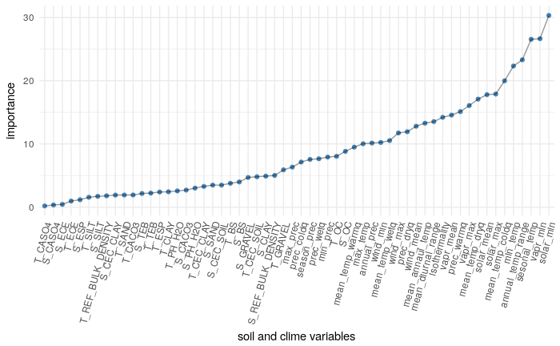
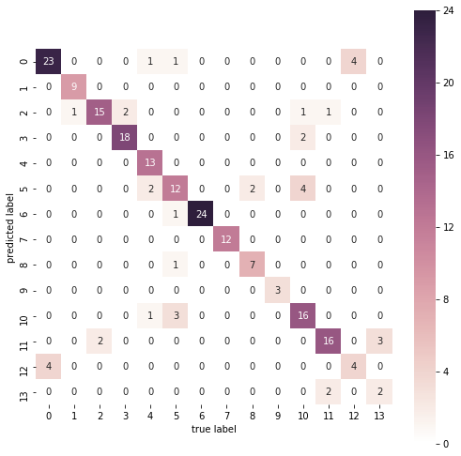
Datasets: WorldClime and SoilDB
Admixture components are more influenced by climate than soil parameters
Climate and soil are not independent (Mantel test p-value 0.03)
Next, predict admixture component class by Climate and Soil.
Accuracy is 0.85

Slide 49
Part 1 conclusion
We can model wild species – not so much luck with domesticated
Climate and soil influence genetics (duh!)

Slide 50
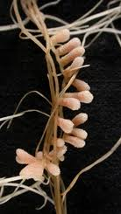
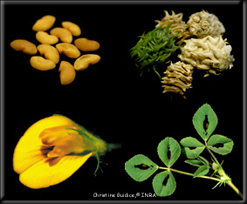
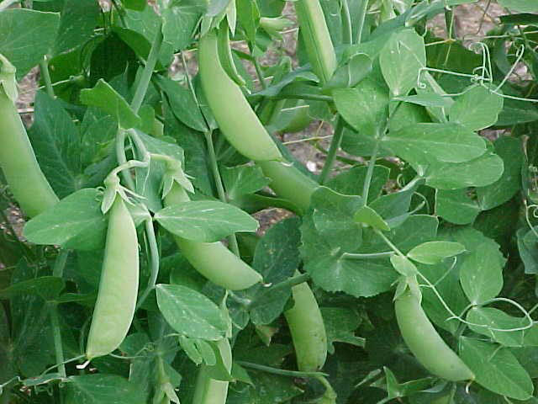
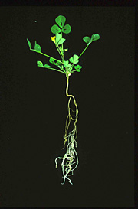
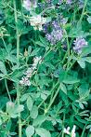
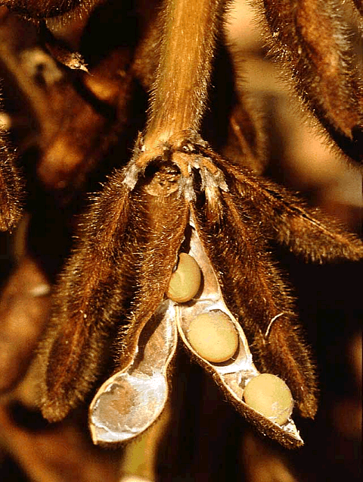
M. truncatula - a model legume plant
Legumes (fabaceae) plant family
Ability to establish nodule symbiosis
High synteny to legume crops
Small diploid genome (500Mb) sequenced Tang et al., 2014 (BMC Genomics)
Numerous genomic resources
RIL populations
Mutant collections
Large EST and RNASEQ databases
HAPMAP resources Branca et al., 2011 (PNAS)
288 genomes already sequenced
Biotechnology tools for validation
Large biodiversity Gentzbittel et al., 2015 (Front. Pl. Sci)
Medicago truncatula
Notes:
50

Slide 51

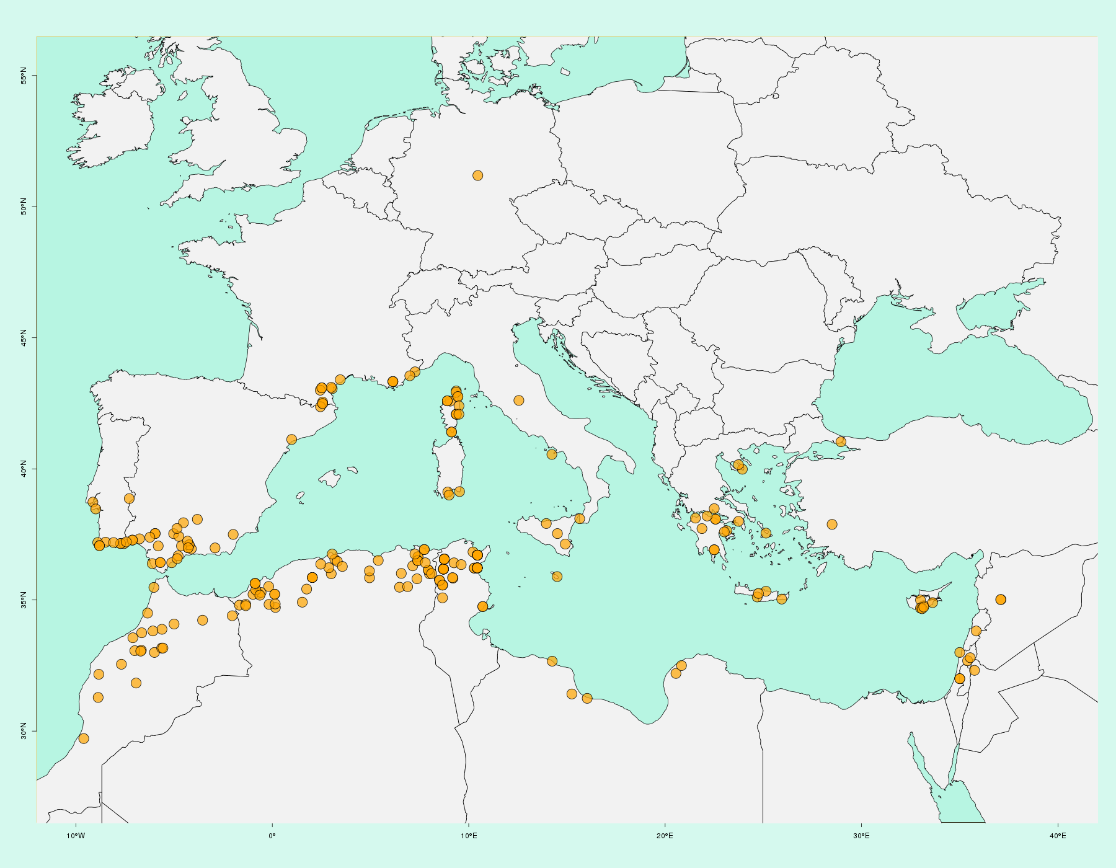
NSF HapMap project
Current state: 288 sequenced accessions
Total: 16.516.721 SNPs
30 lines at > 20X
The rest at > 5X
Branca et al., 2011 (PNAS)

Slide 52
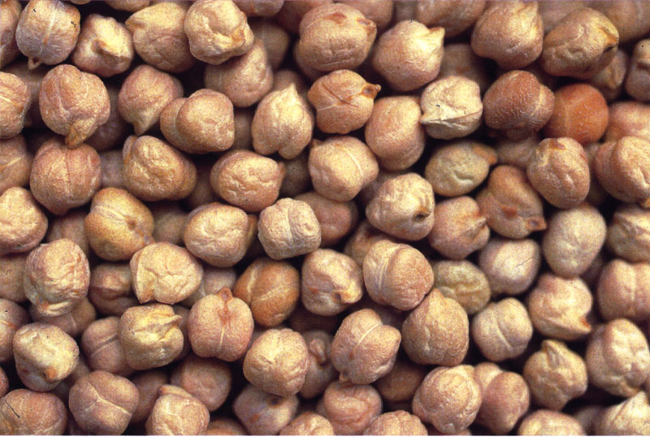
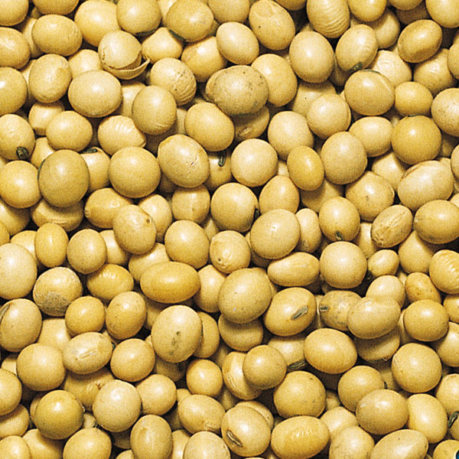
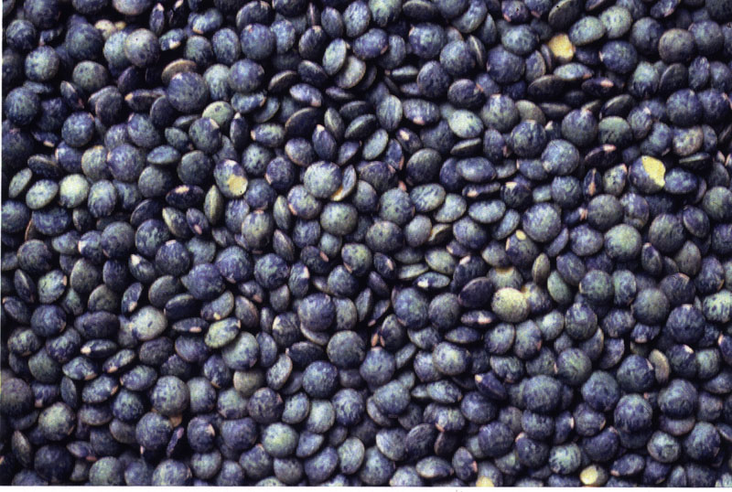

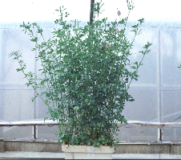
Legumes comprises major agricultural species for human and animal nutrition
Grain Legumes
Forage Legumes
Soybean
Chickpea
Bean
Pea
Peanut
Lentil
Alfalfa
Clover
High agricultural value
Photo: B.Julier
Grain Legumes are very rich in proteins (Pea: 3x more than cereals)
11/12/2020

Slide 53
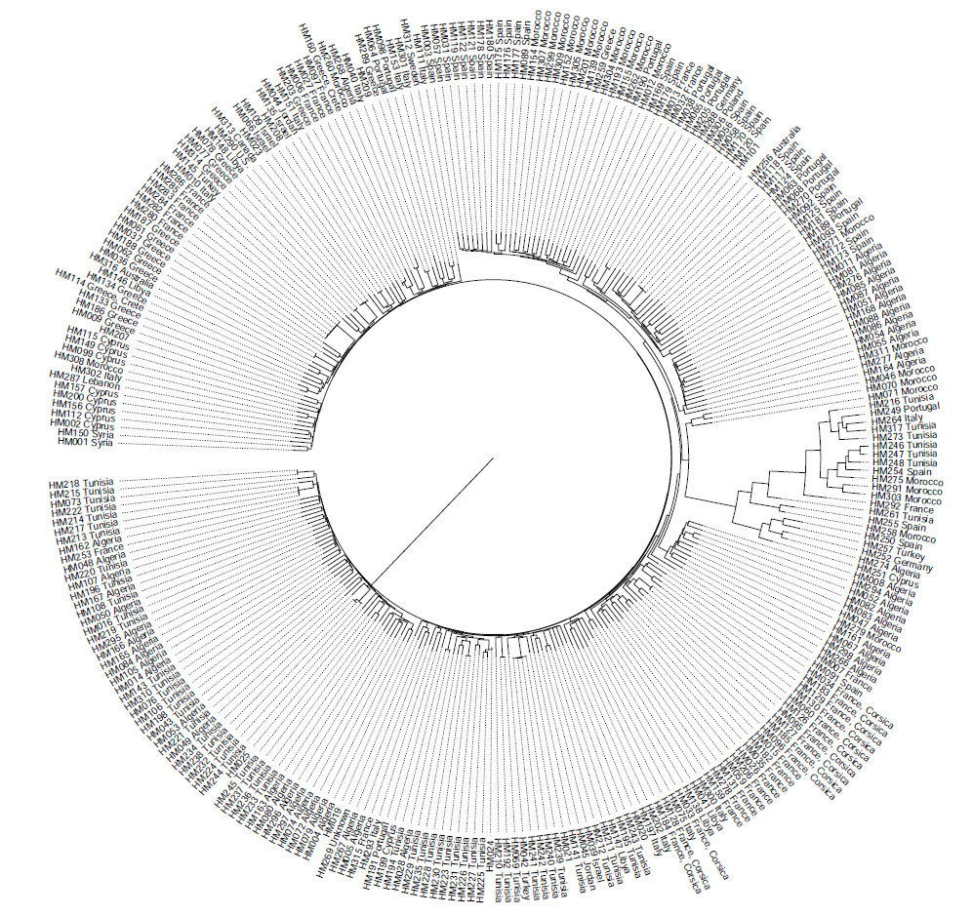
HapMap data for M. truncatula
Current state: 288 sequenced accessions
# SNPs
Chr1 : 1.508.346
Chr2 : 1.964.419
Chr3 : 2.472.365
Chr4 : 2.225.537
Chr5 : 3.251.290
Chr6 : 1.172.980
Chr7 : 2.262.094
Chr8 : 1.659.690
Total : 16.516.721
~ 40% of SNPs in coding regions
18 sister taxa
Here are the data available for the 288 Medicago accessions that have been already sequenced leading to a total number of more than 16.5 million SNP. Among those, 18 accessions which highly diverged from others have been re-classified to some sister taxa despite perfect botanic similarities

Slide 54
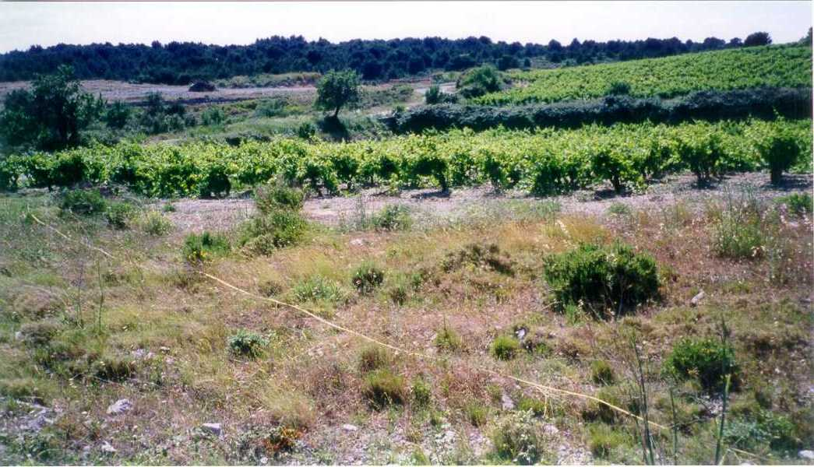
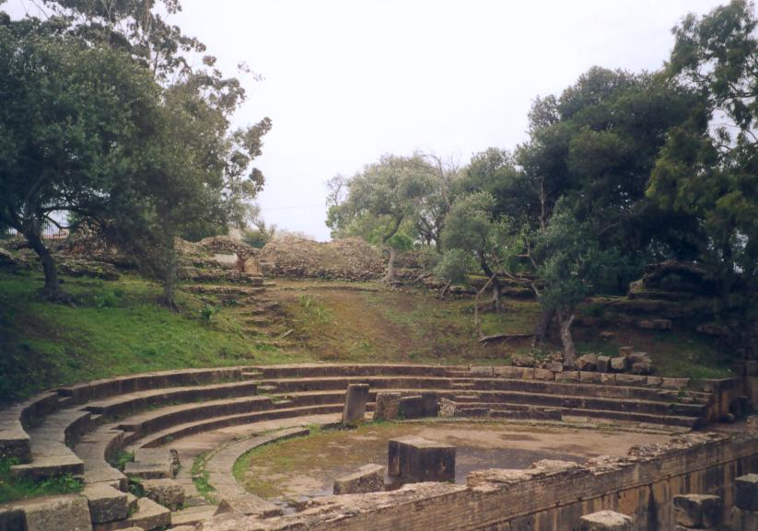
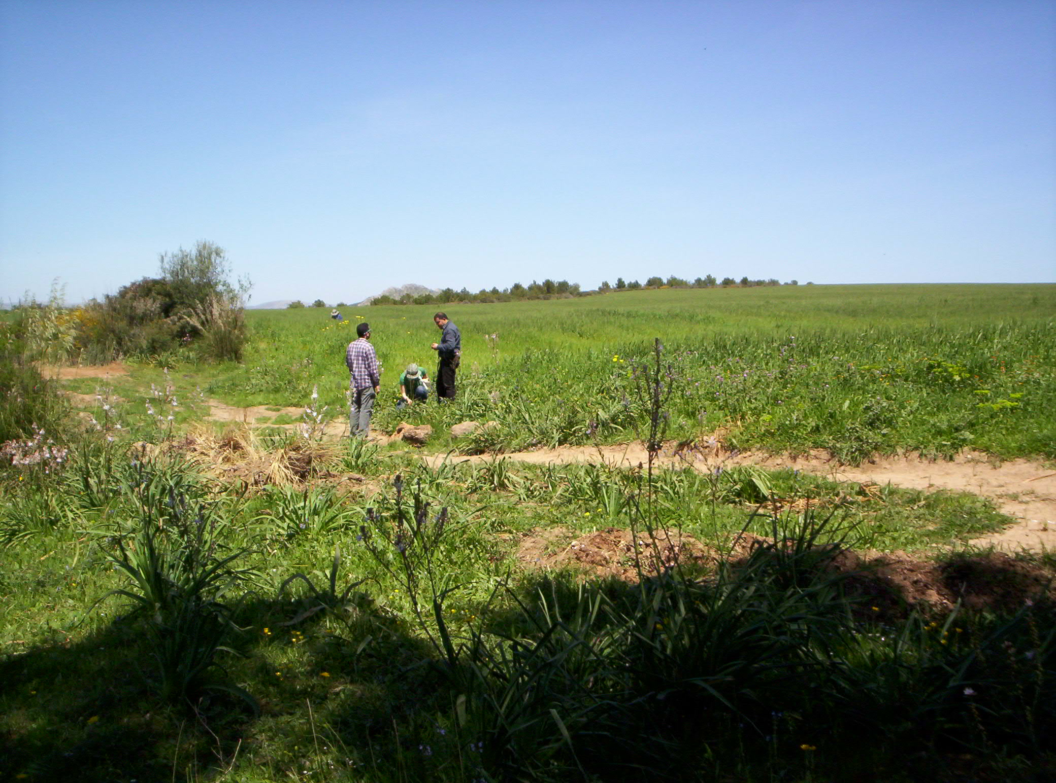
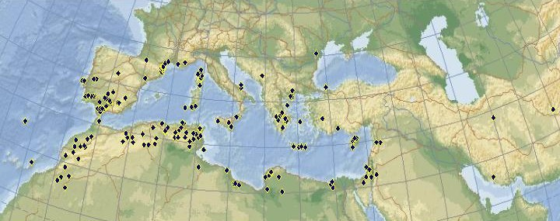



M. truncatula is spontaneously occurring all around the Mediterranean basin
Photo: J-M Prospéri, INRA Montpellier, France
Photo: A.Abdelguerfi, INA, Alger, Algeria
Photo: L. Gentzbittel, ENSAT, Toulouse, France
Photo: J-M Prospéri, INRA Montpellier, France
Photo: E.Aouani, CBBC, Tunisia
Photo: L. Gentzbittel, ENSAT, Toulouse, France
Several collections are available: DZ, TN, FR , AU, US, …. for thousands of accessions

Slide 55



Some ancestral genomes may be adapted to local bio-climatic variables
We looked for putative association with the 19 bio-climatic variables, as defined by WorldClim (http://www.worldclim.org).
Spanish coastal
The “Spanish coastal" genome is
negatively correlated to T°C seasonality (BIO4),
and T°C annual range (BIO7).
Greek
The “Greek" genome is
positively correlated to precipitation of the wettest month (BIO13),
precipitation seasonality (BIO15),
precipitation of the wettest quarter (BIO16)
and precipitation of coldest quarter (BIO19).
BIO4: r=-0.42***
BIO7: r=-0.31***
The “South Tunisian Coastal" genome is
positively correlated to annual mean T°C (BIO1) and Mean T°C of colder quarter (BIO11)
and negatively correlated to annual precipitation (BIO12).
BIO13: r=0.39***
BIO15: r=0.45***
BIO16: r=0.33***
BIO19: r=0.29***
The “North Tunisian Coastal" genome is not significantly correlated to any bioclimatic covariables.
BIO1: r=0.26***
BIO11: r=-0.24**
BIO12: r=--0.28***

Slide 56


PCA identifies two Medicago sub-populations among 262 accessions
40,000 randomly chosen SNPs
In accordance with results of Bonhomme et al. 2014

Slide 57


A refined population structure for Medicago species using Admixture & GPS algorithms
Fig. 1: BIC as a function of increasing values of K, using Discriminant Analysis of Principal Components (DAPC) applied on the 840K SNP dataset. (Jombart et al 2010)
840K randomly selected SNPs
(~100,000 per chromosome)
Admixture analysis
K=8
'leave-one-out' test for assignation of accessions to actual populations, using inferred ancestral genomes proportions.
Fig. 2: Predicted distance from true origin for each M. truncatula accession using the leave-one-out procedure, for increasing values of K.
Medicago is likely to be structured in 8 ancestral genomes
Choice of # putative ancestral populations
Gentzbittel et al., Genome biol. , 2019

Slide 58

A refined population structure for Medicago species using Admixture & GPS algorithms
Gentzbittel et al., Genome biol. , under revision

Slide 59

Predicted locations of 17 unknown accessions including Jemalong-A17 the reference genome.
'Leave-one Out' procedure accuracy is <300 kilometers
Linear relationship between geographical and genetic distances
when d < 950 km
(R=0.8, p-value=10⁻⁴, Mantel's test)
Gentzbittel et al., Genome biol. , under revision
Notes:
The A17 accession, isolated from the Australian Jemalong cultivar (T. Huguet, personnal communication), served as the M. truncatula reference genome (Young et al.2011; Tang et al. 2014). Origins of the Jemalong cultivar are not documented in the litterature and official certificate of Australian administration did not clearly state its primary location in the Mediterranean Basin. The GPS analysis shows that the admixture components of A17 are identical to accessions belonging to the 'Spanish Coastal population', ESP031-A (HM117) and ESP095-C (HM120), and that A17 is closely related to HM058/HM063/HM092/HM117/HM118/HM120/HM125/HM181/HM271. Additionally, the PI442895SSD (HM256) accession is placed in Spain, at the same location to that of the Jemalong-A17 accession. Inspection of online archival records for that accession reported it as the original population of the Jemalong cultivar. These two elements strongly suggest the original geographical position of the A17 reference accession as being of Spanish Coastal, in the region North to Almeria. The PI564941SSD (HM262) accession is placed in Morrocco, in accordance with partial record of its origin.
Interestingly, we were also able to identify the putative locations of ve cultivated varieties of M.
truncatula . It appears that the genetic basis of these cultivars is quite reduced, as 4=5 are part of the 'Greek genome'. As a consequence, their location is quite imprecise and corresponds to that described in the ocial passport data (see Supplemental Bibliography) only for three of them. Borung (HM019, 'Atlas' genome) reported to be collected between Le Kef and Le Krib, Tunisia, is accurately placed. Intriguingly, Caliph (HM207, 'Greek genome), described as a back-crossing program using Cyprus as the recurrent parent, is not located as the same place as Cyprus. Refaire la figure en mettant des couleurs diff pour A17 et cultivars

Slide 60

A refined population structure for Medicago species using Admixture & GPS algorithms

Slide 61



Geographic distribution of the putative 8 ancestral genomes of M. truncatula
Algiers
Spanish coastal
French (K6)
Spanish coastal (K2)
Greek (K7)
North Tunisian coastal
Atlas
Algiers (K1)
Atlas (K4)
North Tunisian coastal (K3)
Atlas
Spanish-Moroccan Inland (K8)
South Tunisian coastal
French
South Tunisian coastal (K5)
5 out of 8 populations are present in Mahgreb
French
Maghreb as a putative center of diversity for
M. truncatula species
Gentzbittel et al., Genome biol. , 2019
Greek
Spanish-Moroccan Inland

Slide 62



Last glaciations & main glacial refugia may explain M. truncatula population structure
-20.000 BP

Slide 63

Admixture components are correlated with current conditions
Gentzbittel et al., Genome biol. , 2019

Slide 64

Verticillium sp. are soil-borne fungal pathogens for Legumes

Slide 65



Ancestral genomes may present different levels of resistance to Verticillium wilt
V. alfalfae symptoms on susceptible M.truncatula (Ben et al. 2013)

Slide 66

Ancestral genomes present different levels of resistance to Verticillium wilt
Linear Model (242 Mt HAPMAP accessions)
MSSCorLS ~ K2 + K5 + K7 + K8
r²=0.31, P-value < 2.2 x 10⁻¹⁶
Gentzbittel et al., Genome biol. , 2019

Slide 67

Can phenotype be predicted using WhoGem?
Use plant model (Medicago truncatula) to test applicability of admixture framework to predict phenotypes.
GPS was used to predict provenance of 59 unknown M. truncatula accessions, and MSS was inferred based on the similarity of admixture profiles to the training set accessions using WhoGem model.
M. truncatula was infected with V. alfalfae and wilting symptoms recorded.
MSS (Maximum symptom score) ranges from 0 (healthy) to 4 (dead), 2 threshold.
V. alfalfae symptoms on susceptible M.truncatula (Ben et al. 2013)
We thank Jean-Marie Prospéri (INRA Montpellier, France) for providing seeds of the accessions

Slide 68



Experimental validation of predicted resistance levels
21/29 samples that are predicted to be resistant were resistant
24/30 samples predicted to be susceptible were susceptible
Chi-square P-value = 1.5.10⁻⁴
Gentzbittel et al., Genome biol. , under revision

Slide 69

WhoGem models can be significant predictors of quantitative functional traits in plants
Comparisons of accuracy of prediction for several quantitative traits of adaptive relevance in M. truncatula using 5 Genomic Selection algorithms and our WhoGEM method.
Accuracy is computed using 50 runs of five-fold cross-validation for all methods.
Gentzbittel et al., Genome biol. , 2019

Slide 70



What is missing?
Distance between two points should not be just geometric distance. Add:
Mode of propagation (e.g. Medicago seeds stick to goats)
Soil
Climate
Geography

Slide 71
 | MAX correlation | MIN correlation | Positively correlated with | Negatively correlated with
K1 | 0.42 | -0.31 | Isothermality | Precipitation of Wettest Quarter
K2 | 0.42 | -0.46 | Precipitation in February | Mean Diurnal Range (Mean of monthly (max temp - min temp))
K3 | 0.40 | -0.25 | Precipitation in August | Precipitation in March
K4 | 0.67 | -0.40 | Precipitation in May / June | Min. temperature in November
K5 | 0.34 | -0.31 | Temperature Annual Range | Precipitation in March
K6 | 0.74 | -0.31 | Latitude | Precipitation of Wettest Quarter
K7 | 0.59 | -0.51 | Temperature Seasonality/Max Temperature in July | Isothermality
K8 | 0.63 | -0.59 | Precipitation in December/ January / Coldest Quarter | Longitude

Slide 72

 | MAX correlation | MIN correlation | Positively correlated with | Negatively correlated with
K1 | 0.16 | -0.10 | material | limiting use factor
K2 | 0.32 | -0.24 | Usage/Slope | texture, grain size
K3 | 0.13 | -0.21 | limiting use factor | erodibility
K4 | 0.27 | -0.20 | soil crusting texture factor | slope
K5 | 0.15 | -0.24 | root obstacle depth | erodibility
K6 | 0.28 | -0.52 | material | subsurface
K7 | 0.46 | -0.21 | slope | Crusting
K8 | 0.56 | -0.27 | Texture | slope

Slide 73

Soil/Climate

Slide 74

Part 2 conclusions
Large proportion of phenotypic variation between individuals may be best explained by population admixture.
Variation in genome admixture proportion explains most of phenotypic variation for quantitative functional traits.
We experimentally confirm the prediction of differences in quantitative disease resistance levels in the wild model legume Medicago truncatula.
Admixture components were found to be significantly related to climate and geography, also positive selection at the species level might not explain current adaptation.
Phenotypes can be predicted using genome-wide patterns of admixture, when incorporating covariates such as individuals' provenance.
This insight contributes to the understanding of adaptation, and can accelerate plant and animal breeding, and biomedical research programs.
This methodology may serve as a basis for analyses in other plant species and for other functional quantitative
traits of interest.

Slide 75
Practice
Admixture.csv
Pheno.csv

Slide 76

ADM=read.csv("Admixture.csv",row.names = 1)
# Instruction to name bars:
barNaming <- function(vec) {
retVec <- vec
for (k in 2:length(vec)) {
if (vec[k - 1] == vec[k])
retVec[k] <- ""
}
return(retVec)
}
# Size of the plot - these are margins, also related to the end appearance of the plot
par(mar = c(1, 1, 1, 1))
x=barplot(t(as.matrix(ADM[, 7:14])),
col = rainbow(8),
horiz = FALSE,
las = 2,
cex.axis = 0.1,
cex.names = 0.65,
)
text(x,0.5,barNaming(ADM$Country),srt=45, col='white')

Slide 77

Clustered vectors

Slide 78
Merge datasets
ADM=read.csv('Admixture.csv',row.names = 1); TEST=subset(ADM, is.na(ADM$Lat))
REF=subset(ADM, !is.na(ADM$Lat)); Phen=read.csv('pheno.csv',row.names = 1); head(Phen)
#merge reference adm with pheno
AMDPH=na.omit(merge(REF, Phen, by='row.names'))

Slide 79
DATA=AMDPH[,c(4:6,8:15,17)]; cor(DATA)
 | Lat | Long | Elev | K1 | K2 | K3 | K4 | K5 | K6 | K7 | K8 | MSS
Lat | 1 | -0.1208 | -0.08527 | -0.0795 | 0.031188 | -0.05421 | -0.15353 | -0.20474 | 0.759062 | -0.13096 | -0.15013 | 0.031638
Long | -0.1208 | 1 | -0.19809 | -0.15237 | -0.40834 | 0.075826 | 0.004852 | 0.248445 | -0.04453 | 0.703125 | -0.54288 | 0.39841
Elev | -0.08527 | -0.19809 | 1 | 0.31451 | -0.07847 | -0.18658 | 0.268594 | -0.23606 | 0.001009 | -0.18933 | 0.069882 | -0.004
K1 | -0.0795 | -0.15237 | 0.31451 | 1 | -0.10838 | -0.1018 | -0.11645 | -0.12181 | -0.09978 | -0.15409 | 0.025256 | 0.030009
K2 | 0.031188 | -0.40834 | -0.07847 | -0.10838 | 1 | -0.09725 | -0.19296 | -0.13028 | -0.10436 | -0.16469 | -0.02408 | -0.35086
K3 | -0.05421 | 0.075826 | -0.18658 | -0.1018 | -0.09725 | 1 | -0.12727 | -0.06539 | -0.11848 | -0.14095 | -0.15113 | 0.152299
K4 | -0.15353 | 0.004852 | 0.268594 | -0.11645 | -0.19296 | -0.12727 | 1 | -0.14567 | -0.19199 | -0.26904 | -0.27647 | 0.056788
K5 | -0.20474 | 0.248445 | -0.23606 | -0.12181 | -0.13028 | -0.06539 | -0.14567 | 1 | -0.14277 | -0.04562 | -0.18434 | -0.09248
K6 | 0.759062 | -0.04453 | 0.001009 | -0.09978 | -0.10436 | -0.11848 | -0.19199 | -0.14277 | 1 | -0.14562 | -0.19251 | 0.086721
K7 | -0.13096 | 0.703125 | -0.18933 | -0.15409 | -0.16469 | -0.14095 | -0.26904 | -0.04562 | -0.14562 | 1 | -0.25092 | 0.343465
K8 | -0.15013 | -0.54288 | 0.069882 | 0.025256 | -0.02408 | -0.15113 | -0.27647 | -0.18434 | -0.19251 | -0.25092 | 1 | -0.30013
MSS | 0.031638 | 0.39841 | -0.004 | 0.030009 | -0.35086 | 0.152299 | 0.056788 | -0.09248 | 0.086721 | 0.343465 | -0.30013 | 1

Slide 80
##GPS
M=25;
for(i in 1:dim(TEST)[1]){
Y=TEST[i,7:14];Y
DIST=c()
for(j in 1:dim(AMDPH)[1]){
Z=AMDPH[j,8:15];Z
d=sum((Y-Z)^2);d
DIST=c(DIST,d)
}
I=order(DIST)[1:M];I
Ph=AMDPH$MaxSymptomScore[I];Ph
Dist=DIST[I]+1.E-15;Dist
w=min(Dist)/Dist;w
predPh=sum(w*Ph)/sum(w);predPh
predLat=sum(w*AMDPH$Lat[I])/sum(w);predLat; predLon=sum(w*AMDPH$Long[I])/sum(w);predLon
output=paste(row.names(TEST[i,]),TEST$Pop[i],TEST$Country[i],predPh,predLat,predLon, sep=',')
write.table(output,"GPS_RES.csv",append = T, row.names = F, col.names = F, quote=T)
}

Slide 81
Results
Sample | Pop | Country | MSS | Lat | Lon
HM112 | SA28097 | Cyprus | 2.972435 | 36.44321 | 26.17896
HM115 | Cyprus_C | Cyprus | 2.972435 | 36.44321 | 26.17896
HM313 | PI660408SSD | Cyprus | 2.972435 | 36.44321 | 26.17896
HM111 | SA27192 | Italy | 2.840499 | 36.70259 | 22.93486
HM293 | PI660411SSD | Italy | 2.609747 | 36.17789 | 21.94247
HM197 | SA12455 | Italy/Sardinia | 2.011748 | 39.83869 | 7.174536
HM262 | PI564941SSD | Morocco | 1.728855 | 36.17965 | -5.39374
HM280 | D1.2.3 | Syria | 3.185377 | 38.69052 | 23.28353
HM256 | PI442895SSD | unknown | 0.966927 | 37.095 | -5.132
HM269 | PI660470SSD | unknown | 2.699733 | 36.65048 | 20.22743
HM290 | PI577640SSD | unknown | 2.972435 | 36.44321 | 26.17896
HM316 | PI660421SSD | unknown | 2.972435 | 36.44321 | 26.17896
HM019 | Borung | Unknown-Cultivar | 2.887806 | 36.3135 | 8.496228
HM207 | Caliph | Unknown-Cultivar | 3.182311 | 36.43172 | 24.90595
HM208 | Paraggio | Unknown-Cultivar | 2.134387 | 33.83131 | 26.18263
HM209 | Sephi | Unknown-Cultivar | 2.972435 | 36.44321 | 26.17896
HM101 | A17_Varma | Unknown-Reference | 0.966927 | 37.095 | -5.132

Slide 82
#GLM
library(lmtest); library(dplyr); library(car); library(rcompanion)
#set up formulas
formula=formula(MaxSymptomScore~K1+K2+K3+K4+K5+K6+K7+K8)
formula0=MaxSymptomScore ~ 1
#initialize models
model.null = glm(formula0, data=AMDPH); summary(model.null)
model.full = glm(formula, data=AMDPH); summary(model.full )
#perform stepwise reduction
S=step(model.null, scope = list(upper=model.full), direction="both", test="Chisq", data=AMDPH)
summary(S)
#final model
model.final = glm(S$formula, data=AMDPH);model.final
summary(model.final)
AMDPH$predy = predict.glm(model.final, newdata = AMDPH, type="response" )

Slide 83







Collaborations and funding
Laurent Gentzbittel, Ecolab, Toulouse, France/Skoltech, Moscow, Russia
Nevin Young's lab, Univ. of Minnesota, USA
Sergey Nuzdhin's lab, USC, USA
Chris Town's lab, JCVI, USA
Mounawer Badri & Naceur Djebali, CBBC, Tunisia
Jean-Marie Prospéri, INRA Mauguio, France
Nick Alexandrov & Dmitro Chebotarov, IRRI, Philippines
Laurent Gentzbittel

Slide 84



Thank you for your attention！

